Slide 1
FUZZY C MEANS CLUSTERING
SOBHAN MISHRA(22CE10075)

Slide 2
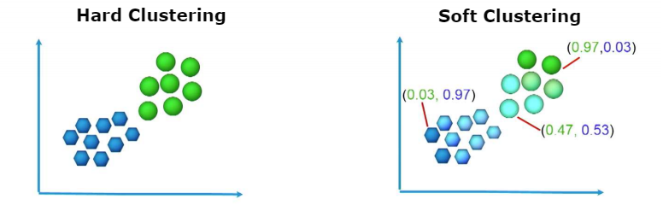
LITERATURE REVIEW
FUZZY C-MEANS (FCM) IS A FORM OF UNSUPERVISED IN WHICH DATA IS CLUSTERED INTO A NUMBER OF CLUSTERS TO DETERMINE SIMILIARITY
IN FUZZY C-MEANS CLUSTERING EACH DATA POINT CAN BELONG TO MULTIPLE CLUSTERS WITH DIFFERENT MEMBERSHIP VALUES UNLIKE THAT IN K MEANS CLUSTERING WHERE EACH DATA POINT BELONGS STRICTLY TO ONE CLUSTER
FUZZY C-MEANS CLUSTERING PROVIDES A PROBABILISTIC WAY TO CLUSTER DATA

Slide 3
LITERATURE REVIEW
IN THE CONTEXT OF TRAFFIC ENGINEERING, FUZZY C-MEANS CAN BE USED TO DETECT CONGESTION, ANALYSE TRAFFIC FLOW PATTERNS, ANALYSE THE TYPE OF VEHICLES ON A ROAD ,ETC.
IT ALSO HAS APPLICATION IN AIRWAYS AND RAILWAYS AS IN CLUSTERING THE TYPE OF PASSENGERS, CLUSTERING DELAYS, ETC.
WHY FUZZY C-MEANS OVER K MEANS CLUSTERING?
SOFT CLUSTERING
DOES NOT ASSUME SHAPE OF CLUSTERS
OUTLIERS ARE MANAGED PROPERLY
ABILITY TO HANDLE NOISE

Slide 4
METHODOLOGY OF ALGORITHM
THE DATA POINT IS INITIALISED INTO DESIRED NUMBER OF CLUSTERS RANDOMLY WITH SOME MEMBERSHIP VALUES.
CENTROID IS CALCULATED USING THE GIVEN FORMULA-
THE DISTANCE OF EACH POINT FROM THE CENTROID IS CALCULATED.
THE MEMBERSHIP VALUES ARE UPDATED AS-
THE ABOVE STEPS ARE REPEATED TILL THE MEMBERSHIP VALUES BECOME CONSTANT OR THE DIFFERENCE BETWEEN THEM BECOMES LESS THAN THE THRESHOLD.
µ = fuzzy membership value
m = fuzziness parameter (>1)

Slide 5
PROBLEM STATEMENT
ROADMAP
CLUSTERING OF ROAD ACCIDENTS TO DETERMINE THEIR PATTERNS AND ANALYSE THE RISK FACTOR OF DIFFERENT FEATURES CAUSING THESE ACCIDENTS
DETERMINE DIFFERENT FACTORS RESPONSIBLE FOR ACCIDENTS
CLUSTER THESE FEATURES TOGETHER
IDENTIFY PATTERNS FROM THE CLUSTERS
ANALYSE THESE PATTERNS TO DETERMINE REPITITIVE TRENDS
USE THESE TRENDS TO RECTIFY REAL-LIFE CONDITIONS

Slide 6
DATASET
THE DATASET WAS OBTAINED FROM KAGGLE
INDIAN ROAD ACCIDENTS DATASET CONTAINING THE LATITUDE AND LONGITUDE OF ACCIDENTS ALONG WITH OTHER FEATURES WHICH MAY BE RESPONSIBLE FOR THE ACCIDENT LIKE WEATHER, LIGHT CONDITIONS, ETC,
AFTER ANALYSING THE DATASET, WE SELECTED 11 FEATURES WHICH WOULD HAVE AN IMPACT ON ACCIDENT.
LINK TO THE DATASET- https://www.kaggle.com/datasets/data125661/india-road-accident-dataset

Slide 7
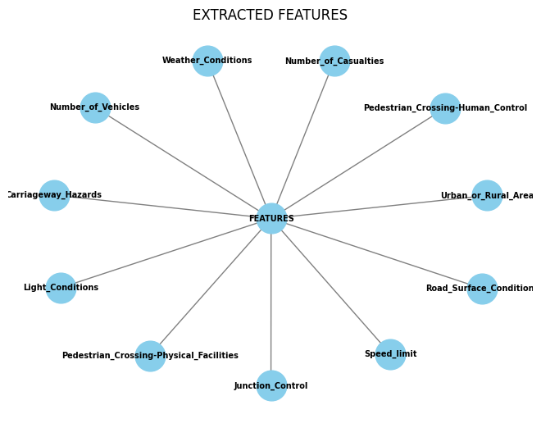

Slide 8
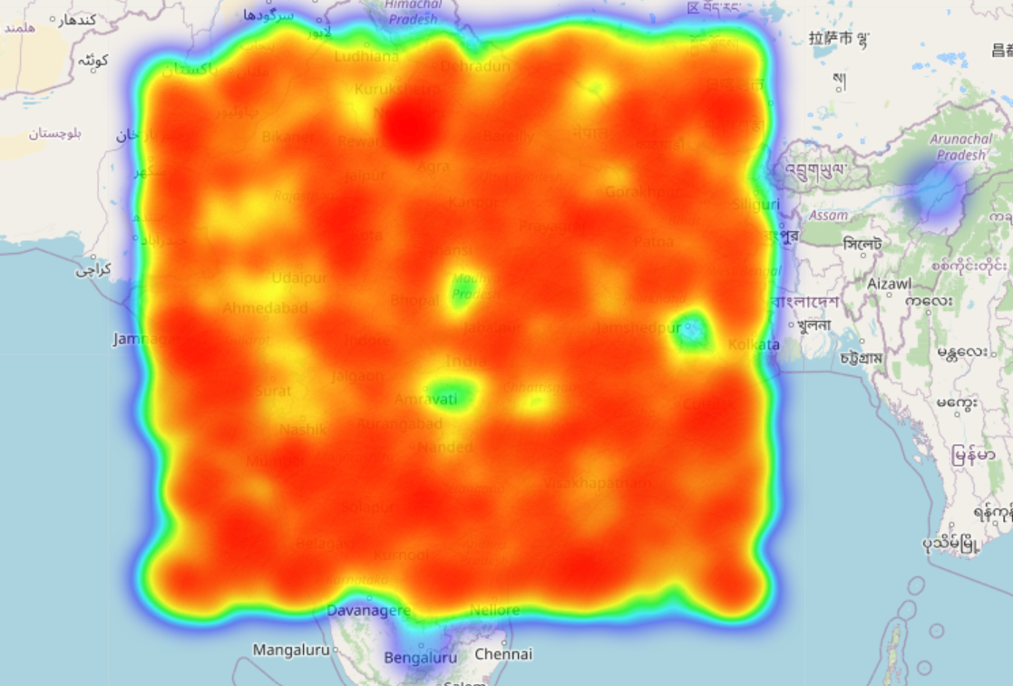
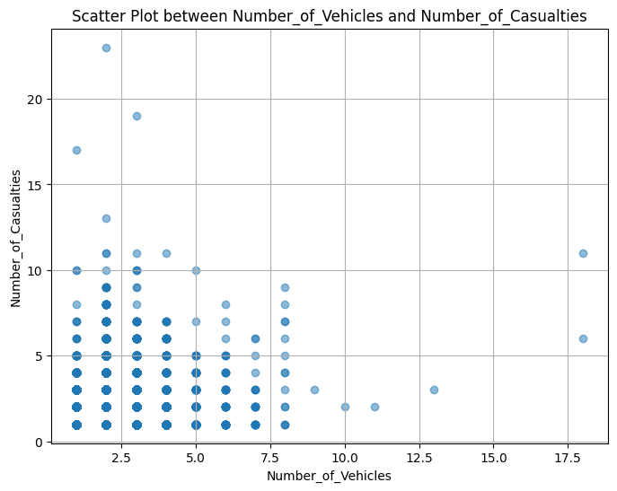
VISUALISATION
FOLIUM HEATMAP DEPICTING THE SEVERITY OF ACCIDENTS GEOGRAPHICALLY
SCATTER PLOT BETWEEN THE NUMBER OF VEHICLES AND NUMBER OF CASUALTIES

Slide 9
DATA PREPROCESSING
REMOVING NULL VALUES FROM THE DATASET
NORMALISING THE DATASET USING STANDARD SCALER
df.dropna(inplace=True)
from sklearn import preprocessing
scaler = preprocessing.StandardScaler()
scaler.fit(df_new[features])
df_new[features] = scaler.transform(df_new[features])
STANDARD SCALER NORMALISES THE SELECTED COLUMNS OF A DATABASE SO THAT THEY HAVE A MEAN OF 0 AND STANDARD DEVIATION OF 1

Slide 10
CODE
MEMBERSHIP CALCULATION
UPDATE THE VALUE OF CENTROIDS
def calculate_membership(data, centroids, fuzziness):
distances = np.linalg.norm(data[:, None, :] - centroids[None, :, :], axis=2) ** (2 / (fuzziness - 1))
return 1 / distances
def update_centroids(data, membership, fuzziness):
membership_powered = membership ** fuzziness
centroids = np.dot(membership_powered.T, data) / np.sum(membership_powered, axis=0)[:, None]
return centroids

Slide 11
def fcm(data, n_clusters, fuzziness=2, max_iter=100, threshold=1e-5):
centroids = np.random.rand(n_clusters, data.shape[1])
for _ in range(max_iter):
membership = calculate_membership(data, centroids, fuzziness)
centroids_new = update_centroids(data, membership, fuzziness)
if np.linalg.norm(centroids_new - centroids) < threshold:
break centroids = centroids_new
cluster_membership = np.argmax(membership, axis=1)
return centroids, cluster_membership
SETTING THE MAXIMUM NUMBER OF ITERATIONS, FUZZINESS AND THRESHOLD
CENTROIDS INITIALISED RANDOMLY
MEMBERSHIP VALUES ARE CALCULATED AND THE NEW VALUES OF CENTROID ARE UPDATED ACCORDINGLY
THIS PROCESS IS REPEATED TILL THE DIFFERENCE IS LESS THAN THRESHOLD
THE CENTROIDS AND MEMBERSHIP VALUES ARE RETURNED
THE DATASET WITH FEAUTURES AND THE DESIRED NUMBER OF CLUSTERS ARE GIVEN AS INPUT AND THE MEMBERSHIP VALUES ARE OBTAINED

Slide 12
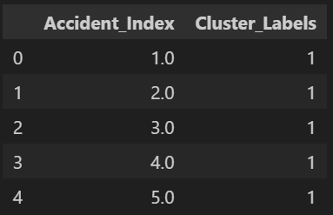
RESULTS
CLUSTER LABELS OF THE FIRST 5 DATA POINTS
SILHOUETTE SCORE CLOSE TO 0 MEANS THAT THE DATA IS WELL CLUSTERED BUT THE CLUSTERS ARE OVERLAPPING
Silhouette Score: -0.0655462101395817

Slide 13
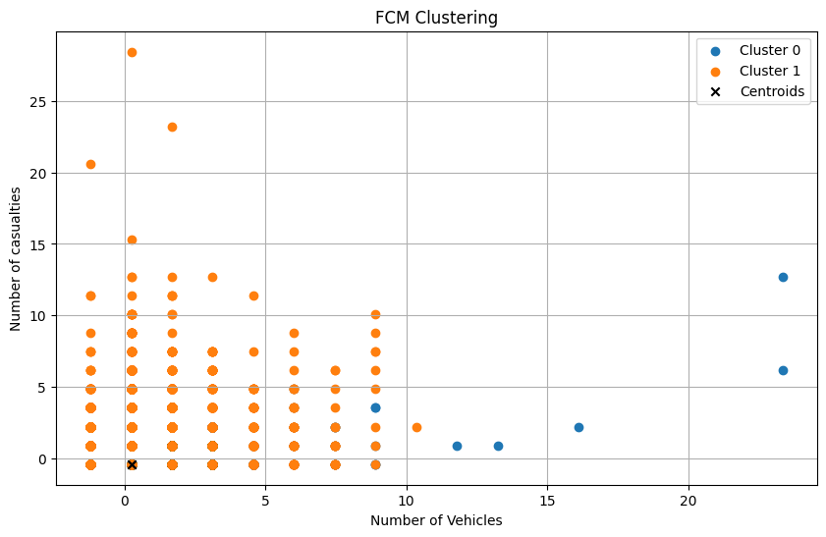
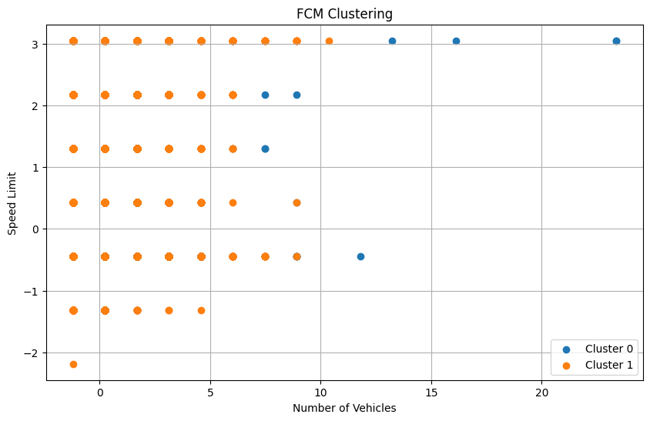
ANALYSIS
SCATTER PLOTS OF THE CLUSTERS OBTAINED FROM FCM

Slide 14
CONCLUSION
BY ANALYSING THE CLUSTERS COMPRISING OF DIFFERENT FEATURES WE CAN OBSERVE THE CONDITIONS IN WHICH ACCIDENTS ARE MORE LIKELY TO OCCUR AND TAKE STEPS ACCORDINGLY TO MINIMISE THEM.
FOR EXAMPLE IN THE CLUSTERS WHERE ROAD SURFACE CONDITIONS AND VISIBILITY ARE POOR, STEPS CAN BE TAKEN FOR BETTER MAINTENANCE OF THE ROADS TO AVOID ACCIDENTS.
SIMILIARLY THERE CAN BE CHANGES IN SPEED LIMITS, ROAD LIGHTING CONDITIONS, PEDESTRIAN CROSSING FACILITIES, JUNCTION CONTROL, ETC.

Slide 15
REFERENCES
CLUSTERING OF TRAFFIC CONGESTION
APPLICATION OF FUZZY C-MEANS IN LEVEL CLUSTERING OF TRAFFIC ACCIDENT VULNERABILITY
https://iopscience.iop.org/article/10.1088/1757-899X/1003/1/012099
https://www.geeksforgeeks.org/ml-fuzzy-clustering/

